Slide 1

Catholic Charities Maine
Outcomes from Connecting to HealthInfoNet, Maine’s Health Information Exchange
Abigail Spadone, BHH Clinical Team Lead, Catholic Charities
Alyssa Pekins, Chief Administrative Officer, Catholic Charities
December 6, 2016

Slide 2

Catholic Charities Maine
Who We Are
One of the largest statewide social service agencies in Maine
Operate 25 Programs in 15 sites throughout the state
Serve over 55,000 people in Maine annually
Serving those in need with special emphasis on Maine’s
most vulnerable populations
Our Mission
Inspired by scripture and the Church’s social teaching, Catholic Charities empowers and strengthens individuals and families of all faiths by providing innovative community-based social services throughout Maine.

Slide 3
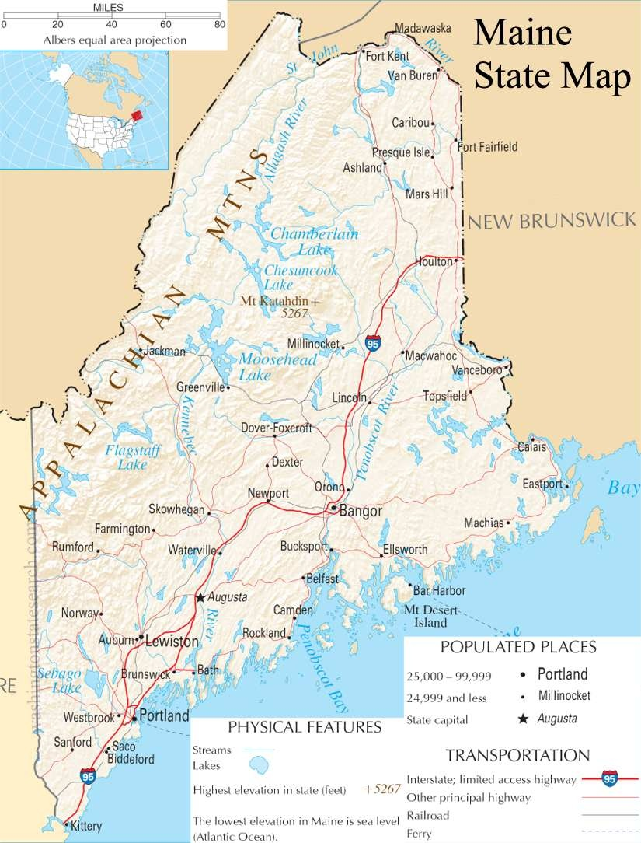
What We Do and Where We Do It
Behavioral Health Network Services
Adult Mental Health Services
Assertive Community Treatment
Community Integration
Behavioral Health Home
Addiction Treatment Services
Outpatient
Intensive Outpatient
Suboxone
Medication Assisted Treatment
DEEP Services
DSAT Treatment
Residential (Halfway house)
Extended Shelter
Children’s Behavioral Health Services
Targeted Case Management
Wraparound Services
Functional Family Therapy©
Notes:
Do we need/want this slide???
Missing the little red stars indicating program location

Slide 4

SIM Funded Intervention
Notes:
We could add a little description of what HIN is in the slide???

Slide 5
Barriers to Innovation
Who had access to HIN?
We had to train staff
How and When do we use this new tool?
Information overload lead

Slide 6

Debriefing Protocol for ED/Hosp. Admissions
How Using HIN to ask the Right Questions supports Follow-up Plans Post-Discharge.

Slide 7
Intervention Workflow/Protocol
HIN Quality Improvement Project: Decrease ED Utilization
HealthInfoNet Notification is Received by Supervisor or Nursing Staff
Within same business day of HIN Notification
Notification is forwarded to Supervisor/Nursing Staff by email to CM/CC/CCSW
CM/CC/CCSW or Team Lead accesses information in HIN to ascertain general details as to location and reason for admit.
Within 24 hours of HIN Notification
CM/CC/CCSW or Team Lead outreaches to Client for status update and schedules face to face visit with client for within 3 business days
Enter “ED/Hospital Admit” info note EHR and secure any additional details from HIN and other resources
Within 3 business days of HIN Notification
CM/CC/CCSW meets with client.
Debriefing is initiated (see structured debriefing protocol)
If possible, outreach to client for status update and any available discharge details. If discharge is same day, begin preparations for debriefing (see structured debriefing protocol).
If possible, meet with the client and initiate debriefing (see structured debriefing protocol).
* Consults occur throughout the process as necessary

Slide 8
Overview of the Debriefing
Overview of Debriefing
What is/was the Presenting Problem
Antecedent to the Presenting Problem
Treatment Efforts made during visit
Duration of stay
Discharge Details
  Different based on if the client was still in the hospital versus back in the community
One month Follow Up

Slide 9
Intervention Sample and HIN
Intervention Sample & HIN
2 or more ED visits in the 6 months prior to the intervention.
ACT, BHH, and 1 CI Team
  Midstream, all CI cases shifted to BHH

Slide 10
Outcomes: ED Utilization
18% decrease in overall ED utilization
50% of ACT clients decreased ED usage
  - Average client decrease in ED utilization = 68%
  78% of BHH clients decreased ED usage
    - Average client decrease in ED utilization = 72%

Slide 11
Moving Forward
Data Driven Decision Making
  Dive into the data to assess for population commonalities that may impact interventions. Revise and repeat.
Leverage HIN
  As a tool to further enhance integrated care partnerships and workflows.
  Expanding ED/Hospital Admissions notifications to ALL ACT, BHH, TCM, CI clients.

